Slide 1
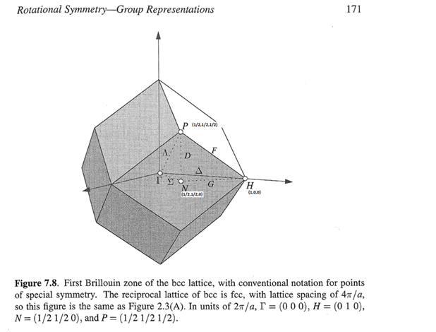
Good for GN
w2nbg = cut(src_nobg,line_proj,0.04,0.04,[-0.1,0.1],[90,110])

Slide 2
w2 = cut(src,line_proj([-1,1,0],[1,1,0]),0.04,[-0.1,0.1],[-0.1,0.1],5)
GN

Slide 3
GN

Slide 4
GN
w2_11 = cut(src_nobg,
line_proj([-1,1,0],[1,1,0],'offset',[1,1,0]),
[0,0.03,2],[-0.1,0.1],[-0.1,0.1],[-50,5,500],
SymopReflection('normvec',[-1,1,0]))

Slide 5
GN
Background

Slide 6
GN
305
300
200
295
290

Slide 7
GN
Reduced background, red line fitted double exponential background, black(green) – 1D average of fig1:
Fitpar:
p: [1 8 71.5080 0.5022 0 0 0 15.6398 0 0]
sig: [0 0 2.3643 0.0144 0 0 0 0.0777 0 0]
bp: [1.4084 0.0261 0.0029 4.5656e-04]
bsig: [0.6440 0.0033 0.0018 0.0029]

Slide 8
GN – top; corrected magnetic form-factor, bg removed

Slide 9
Top of dispersion is shadowed by recoil?

Slide 10
w2_11sym = cut(src_nobg,line_proj([1,1,0],[-1,1,0],'offset',[-1,1,0]),[-2,0.04,2],[-0.1,0.1],[-0.1,0.1],5,
{SymopRotation([0,0,1],45),SymopRotation([0,0,1],135),SymopRotation([0,0,1],180)})

